Slide 1

ONLINE BUS PASS SYSTEM
Software Engineering and Project Management – 18CSC206J
NIKITH KUMAR S –RA1911003020480
VIGNESH P –RA1911003020468
ROHITH S – RA1911003020474

Slide 2
INTRODUCTION
This project was created to provide "safe, reliable, timesaving, efficient, comfortable and affordable" service for people.
It makes the passenger easy to travel with the ticket QR code with the mobile.
So that even if the passenger loses the ticket at the time of checking he can show the QR code.
The TTE can check the QR code with the Admin weather matches or not

Slide 3
PROBLEM STATEMENT
The present conventional method of ticketing is tedious. Since the volume of passengers is very high.
Manual ticket buying concept involves a lot of time, effort and manpower.
This system is highly unsuitable when there is a huge rush of commuters and many times, lot of commuter’s fail to catch their Bus. This is not only affecting the efficiency of people at their work place but also affecting them psychologically by less respect to co-passengers, staff members and at the end of the day at home.

Slide 4
PROPOSAL
The commuters of Public Transport can be categorized in to two categories namely:
1 . Regular commuters
2 . Short Time Commuters
Nowadays , We are using more network and communications with high speed data exchange we are introducing it in a new way to use for ticketing in Public Transport System
In Online Ticketing , a commuter will use his or her Online System to access the bus pass of entry and exit of bus stations. It may be done using mobile network/Net connection. The fair for distance travelled will be deducted from available balance of Debit card/credit cards
Anyone can avail this service by registering account from his or her mobile in a specified registration guidelines and they can start travelling after activation of service.
Using Online for ticketing , it will help to overcome billing hurdles and its fast and widely available network will suitable for communication and information exchange among entry and exit stations, Transport Service Provider Data Centre and Mobile Service Provider for billing purpose.

Slide 5
BUSINESS CASE :
DATE | 03/02/2021
SUBMITTED BY : | NIKITH KUMAR (480) VIGNESH (468) ROHITH (474)
TITLE : | Online Registration of Bus Pass
THE PROJECT:
This Project “Online Registration of Bus Pass “ is a real time project which is useful for the commuters who are facing problems with the current manual work of bus system. It makes the passenger easy to travel with the ticket QR code with the mobile. So that even if the passenger loses the ticket at the time of checking he can show the QR code. The TTE can check the QR code with the admin wheather it matches or not.
THE HISTORY:
Older days, Commuters are used spend more time in Que to register their bus pass . Lot’s of commuter are lose to catch their buses. This is not only affecting the efficiency of people at their work place but also affecting them psychologically by less respect to co-passengers, staff members and at the end of the day at home.

Slide 6
Limitations:
Volume of the Commuter’s is Very High.
Manual buying ticket/bus pass requires lots of time, Effort and Manpower.
Lot’s of travelers are lose to approach their buses at the time.
Approach:
Permission from Authentication process.
Software requirement to build an application.
Permission from Transport Service Provider Data Centre
Benefits:
We can save time.
Quick to catch their booked buses.
This system helps people to make the work a bit faster.

Slide 7
Stake Holders and User Description
STAKE HOLDERS:
User:
The users are the persons, who are using the online web or online services to register the bus pass.
Sponsor:
A sponsor is the person or group that provides the financial resources in kind or in cash for the project.
Program Manager:
They are responsible for managing related project in a coordinated way to obtain benefits and control.

Slide 8
Project Team :
A project team is comprised of the project manager, project management team and other team members who carry out the work.
Function Manager :
They are key individual who play a management role within an administrative or functional area of the business such as human resources, finance, accounting or procurement.
Transporters and Commuters management system :
This system is responsible for generating a message alert to the Bus pass Holders .
Registered Users :
After the Bus Pass Holder/Commuters has book their tickets/bus pass they can receive their ticket number(QR code)/bus pass application number.

Slide 9
USER STORY :
User’s End :
After Registration bus pass, the user will receive the message to their registered mobile or mail ID.
Advertising :
This agency promote the service through call centers, newspapers and even through the display the posters near bus stations.
IT Executive :
The agents will help to solve the Queries of the Commuters.
Technical Departrment :
The Employees in the technical department will be updating the web browser and solve the technical glitches/problems when arised.

Slide 10
MODULE :
Operating Module :
Secure payment
Application management
Receives message alert notification for renewal of bus pass.
User Module :
Registering User
Updating Information
Generating pass
Renewal pass
Generating PDF
Generating QR Code
Problems faced :
Delaying in creation and deletion of message notification.
Tendious procedure for issuing/renewing passes.

Slide 11
Registration Process :
REGISTRATION
New User
Existing User
Login
Login
Form Registration
Renewal
Verification
Renewal Form
Payment
Payment
Bus Pass Generated

Slide 12
COMPARSION BETWEEN WATERFALL MODEL AND AGILE MODEL
WHY AGILE MODEL IS BETTER THAN WATERFALL MODEL??????
1. The Agile Model is based on iterative development and hence it divides the entire project into smaller parts which reduces the risk factor which is not the case in waterfall model.
2.The Waterfall model cannot accept the changes in requirements but in agile model it is easy to change the system requirements.
3.In agile model, the entire project is divided into smaller parts which helps to minimize the project risk and to reduce the overall project delivery time requirements.
4. In waterfall model since risk factor is high, it is not suitable for complex projects.
5.In waterfall model the testing is done in later stage it does not allow identifying the challenges and risks in the earlier phase, so the risk reduction strategy is difficult to prepare, which is not the case in agile model.

Slide 13
6. In waterfall model, it follows a sequential approach whereas in agile model it explains the process in order of incremental approach.
7.In agile it performs the testing concurrently with software development whereas in waterfall model the testing comes after the build phase only.
8.In agile model the distance between the customer and developer is in short whereas in waterfall model it is long.
9.In agile there can be done any change in the project but in waterfall model there is no changes throughout the project work.

Slide 14
IDENTIFYING THE REQUIREMENTS FROM THE PROJECT STATEMENT
REQUIREMENTS :
The requirement definition is concerned with the analysis of the existing system with the aim of determining and structuring the requirement of the proposed system. It is achieved with the aid of user requirement.
Requirement analysis determines the needs to be fulfilled and what the prepared document should do after completion. For the better understanding of the requirements we will draw the context diagram then build a prototype, analyse the requirements and lastly finalise them. In feasibility we analyses the feasibility of the project in terms of economic feasibility, technical feasibility and operational feasibility.
SYSTEM REQUIREMENTS :
List of City/Local Busses and Bus Stations.
GPS Tracker supported for the city busses.
Alert message generating System(For Renewal Process /Any maintenance Work).

Slide 15
FUNCTIONAL REQUIREMENTS :
REGISTERING USER
UPDATING INFORMATION
GENERATING PASS
RENEWING PASS
AUTHENTICATION OF USER
LOG IN
ONLINE PAYMENT
GENERATING PDF
GENERATING QR CODE
NON-FUNCTIONAL REQUIREMENTS :
RELIABILITY.
AVALIABILITY.
THIS WEB APPLICATION WILL BE AVALIABLE IN FEW LANGUAGES.
SECURITY.
STABILITY

Slide 16
PROJECT PLAN AND PROJECT EFFORT BASED ON RESOURSES
Project Name :
Online Registration of Bus Pass
Project Members :
VIGNESH P –RA1911003020468
NIKITH S -RA1911003020480
ROHITH S -RA1911003020474
The following budget is set according to the requirements :
Resource Requirements | Cost
Advertisement | Rs.3000
Printing | Rs.500
Node.Js | FREE
File | Rs.50
TOTAL | Rs.30550

Slide 17
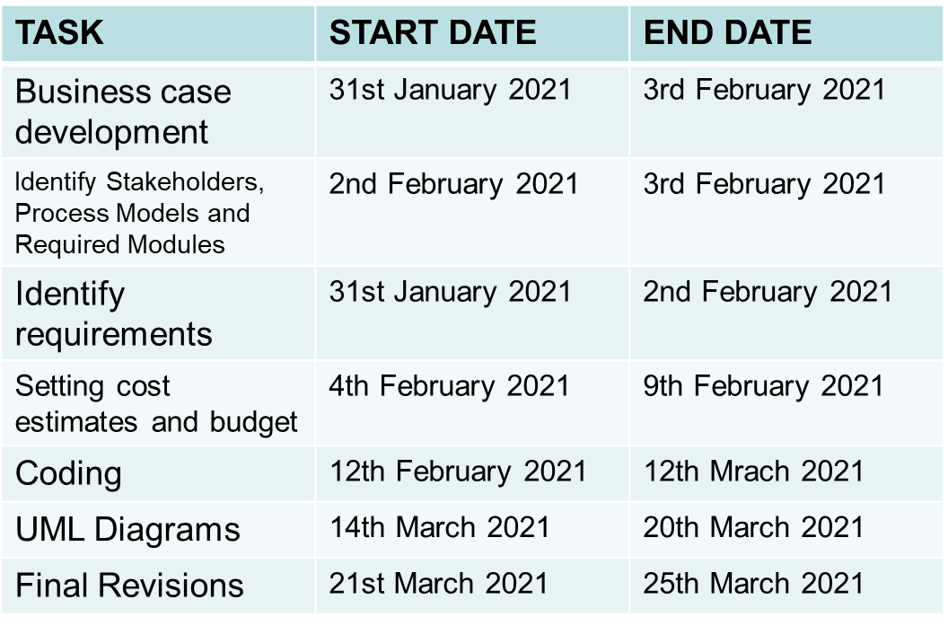
MODULES :
Login
Update
Display
Check
SCHEDULING :

Slide 18
Software and Hardware requirements for the system:
QR code Scanner.
Web Application.
PHP.
Visual Studio Code.
MySQL Databases.
JAVASCRIPT , HTML, Graphics Supported Browser.
System must be Connected to the Server.
Atleast 1GB RAM is required.
Identify Job Roles and Responsibilities :
Members | Roles and Responsibilities
VIGNESH P | Team Leader -Technical Lead -Web Developer
NIKITH S | Team Member -Web Developer
ROHITH S | Team Member -Tester

Slide 19
JOB ROLES AND RESPONSIBILITIES :
PROJECT SPONSOR:
Project sponsor is the one who provides the financial support for the whole project development and execution. They also monitor the process and clarifies scope questions. They also provide expert judgement and dictate milestones, key events, or the project end date.
SUBJECT MATTER EXPERTS (SME):
SME is a person who has a special skills or knowledge on particular job or topic. They have a deep understanding of particular process, function or machine and hence they help to solve the technical challenges faced by the project.
PRODUCT OWNER:
A Product Owner in the Scrum Framework is the single person who is responsible for the success of a Product and for maximizing the value of that Product. In the Scrum Framework, a few of the Product Owners' responsibilities are described, such as Product Backlog management, maximizing value and stakeholder management.
PROJECT MANAGER (PM):
A project manager is a professional in the field of project management. Project managers have the responsibility of the planning, procurement and execution of a project, in any undertaking that has a defined scope, defined start and a defined finish; regardless of industry.

Slide 20
TECHNICAL LEAD:
This person is responsible for overall planning, execution and success of overall complex software solutions to meet customers needs. They have to implement best practice and coding standards to the project. They have to manage the technical scope of the project during and after the delivery.
SOFTWARE DEVELOPERS:
Individual who builds and creates an application is called software developers. They write and debug and then execute the source code of the software application. They are also called as programmers since they are the ones that create the programs or the source code.
SOFTWARE TESTERS:
Their main role is to check if the actual result match the expected result and to ensure the software system is defect free. Software testing helps to identify the errors or the missing requirements due to which it becomes a vital role. It can be either manually or by using automated tools.
USER ACCEPTANCE TESTERS:
This testing is performed by end user or client to accept the software system before moving the software application to the moving environment. This is usually the last process involved in the project management.
WEB DEVELOPER:
A web developer is a programmer who specializes in, or is specifically engaged in, the development of World Wide Web applications using a client–server model. The applications typically use HTML, CSS and JavaScript in the client, PHP in the server, and http for communications between client and server. A web content management system is often used to develop and maintain web applications.

Slide 21
PROJECT EFFORT BASED ON RESOURCES
WORK BREAKDOWN STRUCTURE:
The work breakdown structure of the project is given below:
Online Registration of Bus Pass
Analysis
Requirement
System Design
Development
Testing
Implementation
Feasibility
Functional
System Requirements
Physical system design
QA testing
Acceptance Testing
Online
Users
Non Functional
Website
Maintenance
Designable
Programming
Database
Database
Network
Cost
Materials
Hire programmer
Hire database engineer
Hire network engineer
Update system
Train maintenance

Slide 22
RISK ANALYSIS:
PASSENGER PRIVACY AND DATA:
Passenger details should be provide information about the traveler. We do not sell or share any personally identifiable information volunteered on the bus pass website to any third party(public/private). Any information provided to this portal will be protected from loss, misuse, unauthorized access or disclosure, alteration, or destruction.
BUS PASS ELIGIBLE CRITERIA:
In pursuance of the policy of Central Government, Corporation has implemented the facility of issuing free bus passes to all the Students below 14 years of age, to travel free from the residence to school.
In order to carry their school ID card and Xerox copy of Aadhar card.

Slide 23
Issuing bus passes to the Physically challenged, mentally retarded, blind, deaf & dumb, dwarf persons and etc., and above 60 aged travelers, to travel free by the buses operating in cities / towns. In case of services operating in rural areas, these physically challenged persons are allowed 40%-50 % concession in normal fares.
CRIME:
If your Pass has been stolen, report it to the Police and they will give you a Crime Reference Number. There will be no charge if you order a replacement Bus Pass when you provide your Crime Reference Number. Please be aware you will need to submit a Crime Reference Number during the application.

Slide 24
ESTIMATION OF PROJECT MATRICES Function Point Analysis:
Objective of FPA:
The basic and primary purpose of the functional point analysis is to measure and provide the software application functional size to the client, customer, and the stakeholder on their request. Further, it is used to measure the software project development along with its maintenance, consistently throughout the project irrespective of the tools and the technologies.
Types of FP Attributes
Measurements Parameters Examples
1.Number of External Inputs(EI) - Input screen and tables
2. Number of External Output (EO) - Output screens and reports
3. Number of external inquiries (EQ) - Prompts and interrupts.
4. Number of internal files (ILF) - Databases and directories
5. Number of external interfaces (EIF) - Shared databases and shared

Slide 25
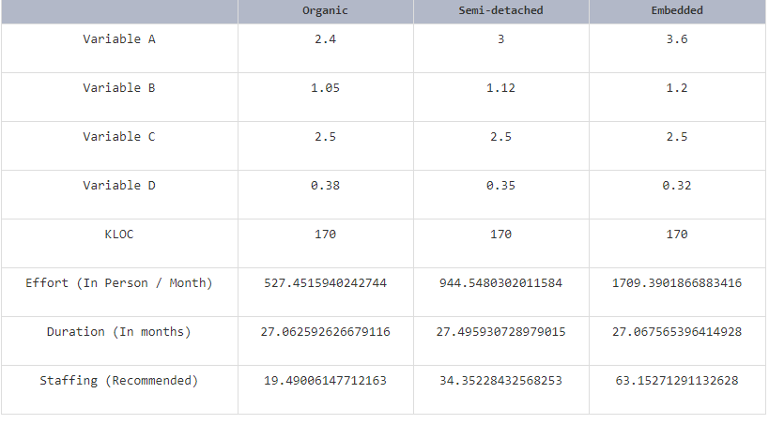
COCOMO Model:
E = ab(KLOC)bb
D = cb(E)b
P = E / D
Where E refers to the effort, D refers to the deployment time ,P refers to the productivity and ab,bb,cb,db are called as coefficients.

Slide 26
SYSTEM DESIGN:
Here we have used the basic software front end design model in order to represent the system architecture of our software model.
LOGIN
REGISTER/
RENEWAL PROCESS
VERIFICATION
LOGOUT
BUS PASS GENERATED
PAYMENT
The above is a simple form of system design diagram which uses front end design.
This shows a loop of functions that need to be executed when this project is implemented. This is a chain of operations through which this project is implemented.

Slide 27
MODELING USE CASE DIAGRAM AND SCENARIOS Use Case Diagram Description
Here there are three actors
User
Admin
TTE
With QR Code:
The registration use case has the relation with both user and admin.
The ID Proof use case has the relation with User have to submit the ID Proof to admin for verification.
User have to pay the amount for the pass.
After payment, User will collect/generate the ticket from the admin.
QR Code use case is related to User, TTE and the admin.
Without QR Code:
If user has lost the QR code pass. User has to buy the ticket or pay the penalty.
In the TTE use case, TTE has submit the records of the travelers to the Admin.

Slide 28
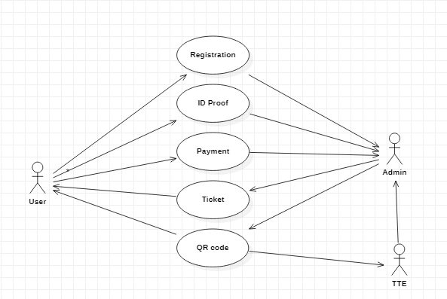
USE CASE DIAGRAM:
WITH QR CODE:

Slide 29
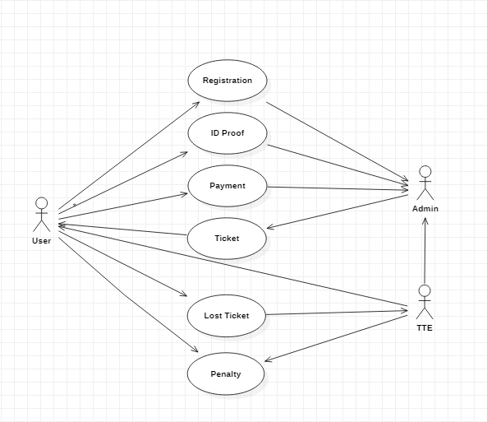
WITHOUT QR CODE:

Slide 30
ER MODELING FROM THE PROBLEM STATEMENT ER DIAGRAM DESCRIPTION:
An Entity-Relationship Model describes interrelated things of interest in a specify domain of knowledge. A basic ER Model is composed of Entity types and specifies relationship that can exist between entities.
The Details of the product are stored in the product tables
Each entity has a primary key and unique keys
The Entities set presented here are
User, Pass registration, Verification and Pass generation.
All the entities like user, type of registration, reduce duplicacy pass.
There is one to one relationship between travelers and the TTE.
The issue is araised when someone misuse the pass/ Stolen by someone.
Another Issues when the user pass has the date of expiration.
Then the request will be sent to the user for renewal of the pass.

Slide 31
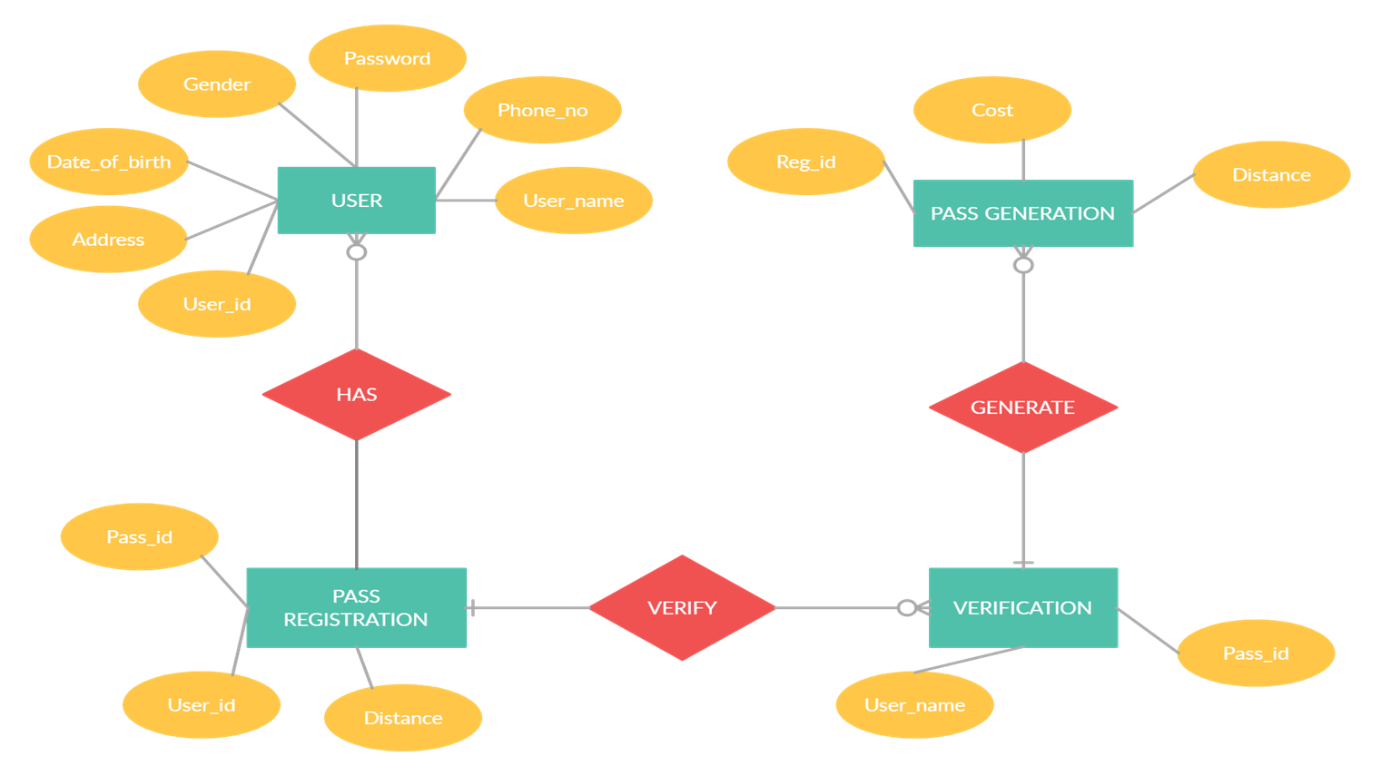
ER DIAGRAM:

Slide 32
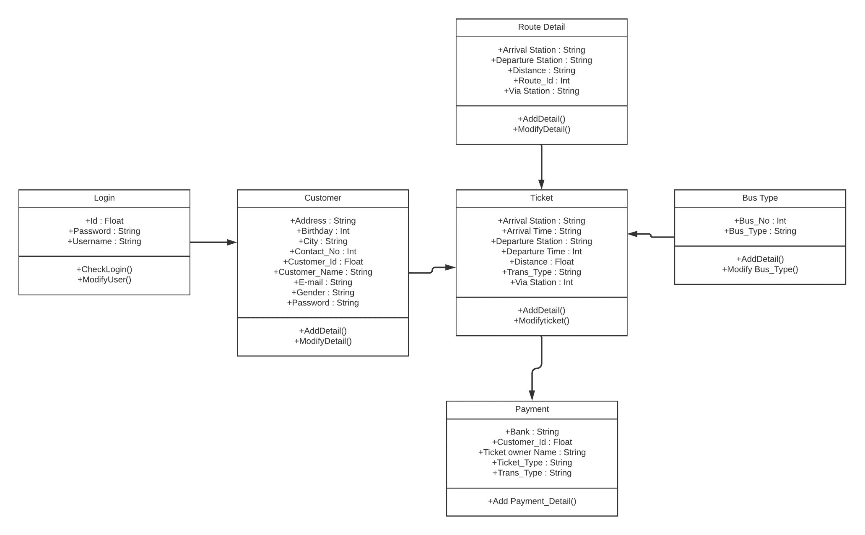
10.1 IDENTIFYING DOMAIN CLASSES FROM THE PROBLEM
10.1.1 DOMAIN CLASS:

Slide 33
10.1.2 DOMAIN CLASS DESCRIPTION:
General description:
A domain class is a class from the Domain Model that Martin Fowler describes as follow in Patterns of Enterprise Application Architecture: An object model of the domain that incorporates both behavior and data. It is based on attributes and stereotypes, etc.
Identifying Stereotypes
Typical domain class stereotypes include:
<<Thing>> = an entity that has mass and volume
<<Event>> = an entity that has a start time and duration
<<Role>> = an entity that executes tasks. For example: plumber, clerk, nurse
<<Type>> = an entity that describes other entities

Slide 34
Identifying Attributes:
A class contains definitions of all of the attributes its instances will contain. An attribute has four attributes:
Name
Type
Visibility (+ | ~ | # | -)
Initial value (optional)
The type of an attribute usually is not a domain class. These kinds of properties will be represented by associations.
Attribute types include:
Primitive types: int, double, Boolean
Foundation classes: String, Money, Date
External/imported classes (i.e., classes from external domains)

Slide 35
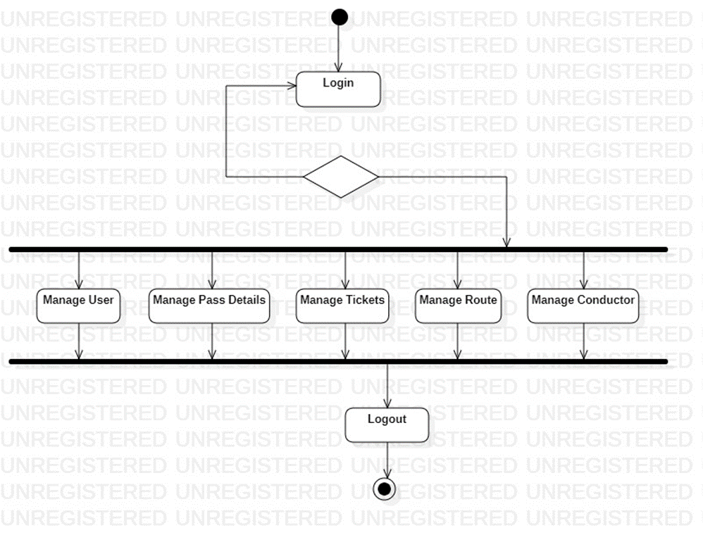
11.1 STATECHART AND ACTIVITY DIAGRAM: 11.1.1 FOR ADMIN:

Slide 36
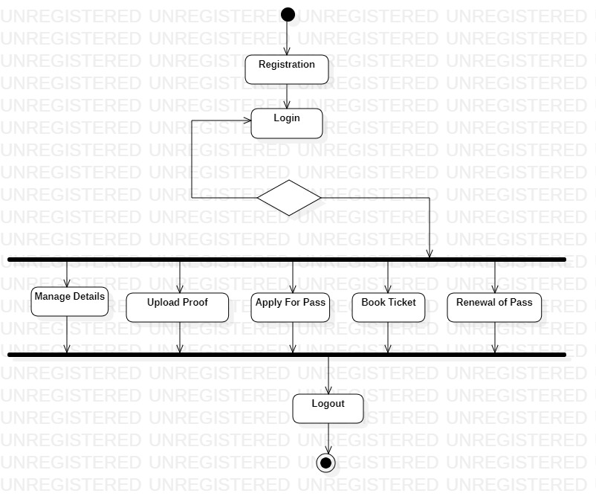
FOR USER:

Slide 37
11.1.2 STATECHART DIAGRAM:
States chart diagram describes the behavior of a single object in response to a series of events in a system.
In this diagrams the states and their descriptions are as follows:
States: State diagram shows the behavior of classes in response to external stimuli.
FOR ADMIN:
Login: This state helps the admin to login to the registration system.
Verify the Validity: The Admin will verifies the customer’s pass validity.
Manage User: This state helps to create the new users without any rate of limit and also update the user properties and their passwords
Manage Pass Details: This System helps the admin to verify the pass details are valid or not and also the expiration of the customer pass.
Manage Tickets: This system helps the user to check the pass are available or not.
Manage Route: This state is manage the area of the district.
Manage Conductor: This system states that the store the details of the conductor and also the manage the trip of the buses are travelling per day.

Slide 38
FOR USER:
Registration: This state helps to register for the new customer.
Login: This state helps the customer to login into bus pass registration.
Validation: This state helps the student valid to bus pass or not.
Manage Details: This state helps the service to find the full details of the customer.
Upload Proof: This state helps the customer to show any proof like aadhar card.
Apply for Pass: This state helps the user to apply for Pass.
Book Ticket: This system helps the customer checks the ticket and makes sure he/she wants to buy the ticket.
Renewal of Pass: This state helps the passenger to verify the expiry date is end or not whether it ends he/she renewal the pass.

Slide 39
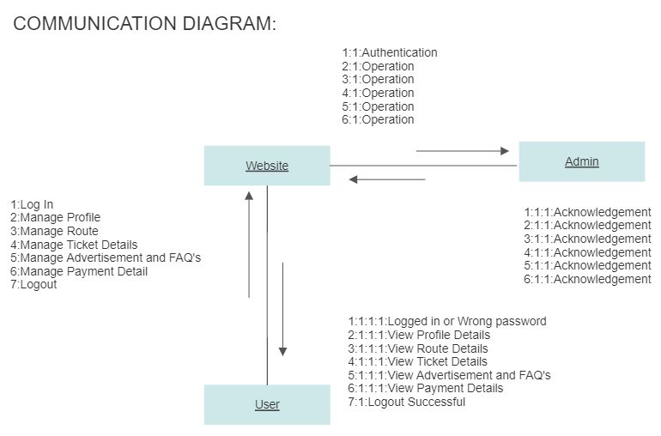
11.1.3 COMMUNICATION DIAGRAM:

Slide 40
11.1.4 COMMUNICATION DIAGRAM DESCRIPTION:
Customer logs into the website.
Customer register his personal details into the website.
Admin receive notification from website and he will verify customer details.
Customer have to select the area where he/ she wants has to travel from source to destination.
Admin will sent the payment response after applied for pass.
Customer will receive pass I.D,Q.R Code from website.
Finally, Customer will logout successfully.

Slide 41
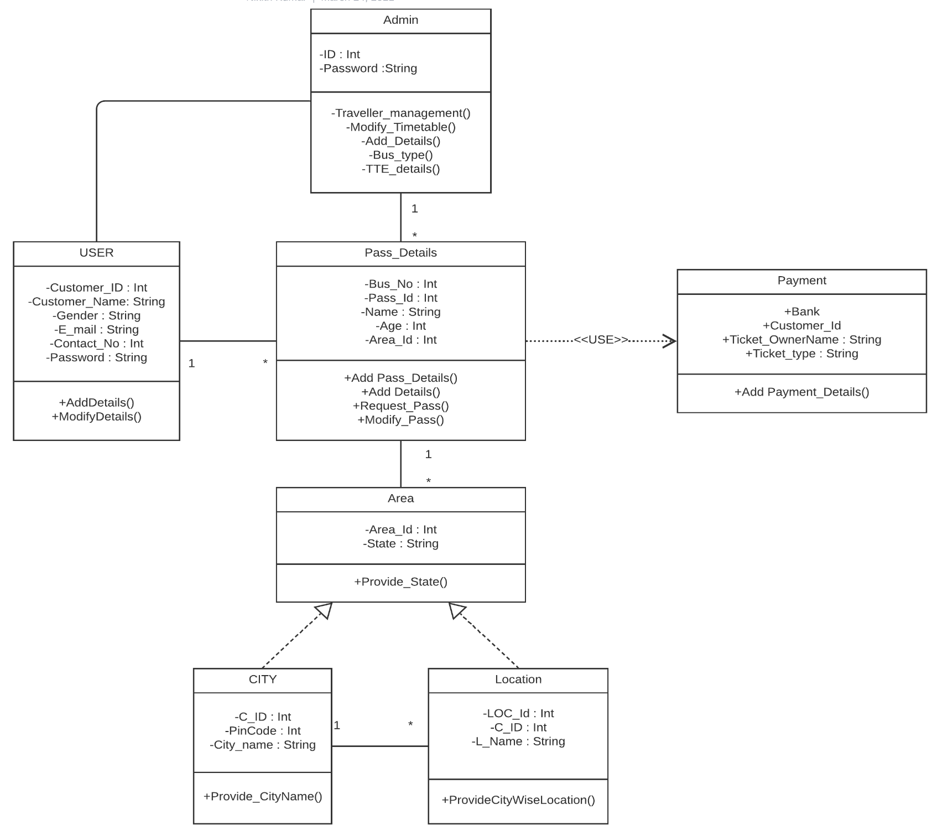
12.1.1 MODELLING UML CLASS DIAGRAM AND SEQUENCE DIAGRAM:

Slide 42
12.1.2 CLASS DIAGRAM DESCRIPTION:
A UML Class diagram is a type of static structure diagram that is used for both general conceptual modelling of the systematics of the application and for detailed modelling translating the model into programming code.
User Registration: This Class is used for the registration of the user.
Pass Details: This class contains all the details like Bus Number, Pass Id, Name, Age, Area of the customer have to mention his/her details.
Payment Method: This Option allows online payment options like UPI, Credit/Debit transactions.
Area in the class diagram is to provide the details of the location in registration of the pass.
The most important relationship in the class diagram is the relationship between the user class and pass details class because it has multiplicity relationship.

Slide 43
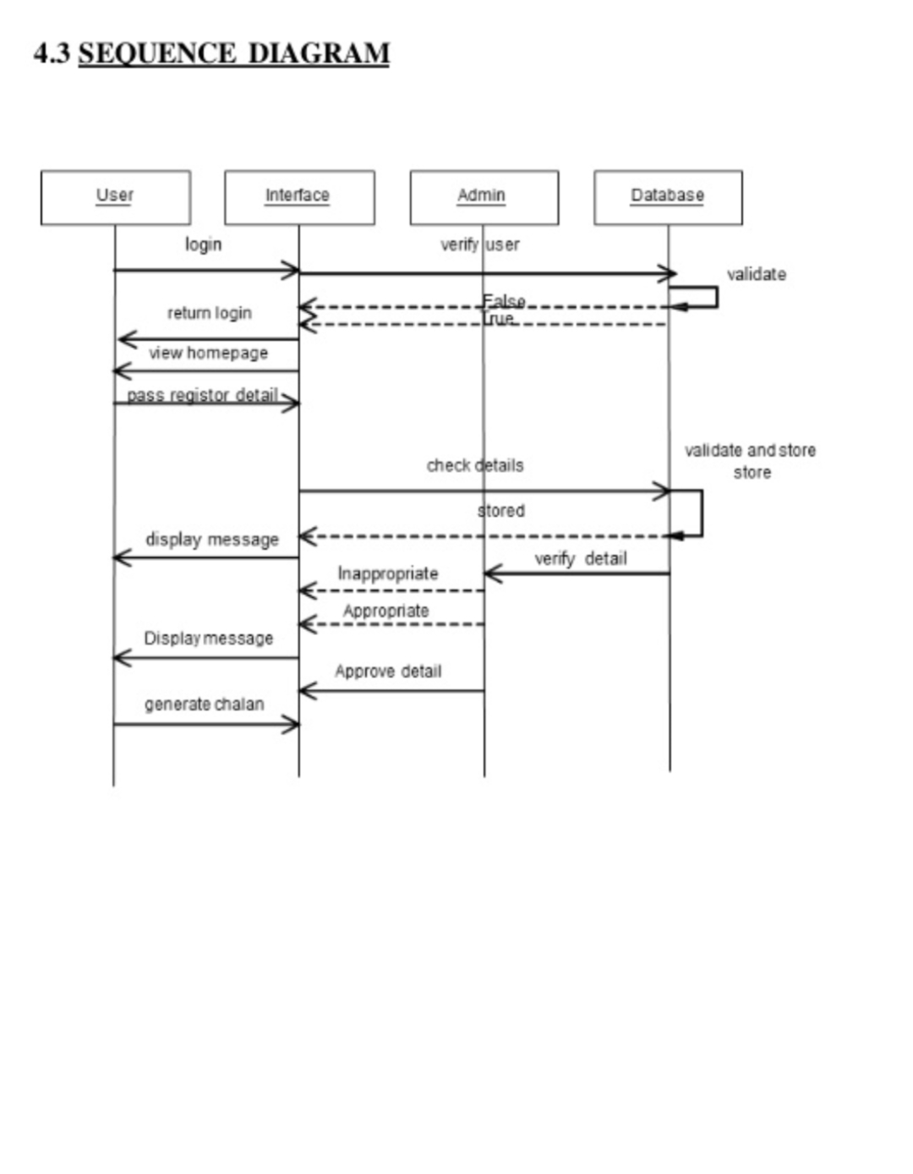
12.1.3 SEQUENCE DIAGRAM:

Slide 44
12.1.4 SEQUENCE DIAGRAM DESCRIPTION:
There are four objects in this diagram:
1.User
2.Interface
3.Database
4.Admin
Customer sends a login request to the database, if user checks the login information whether the user given the information is correct or incorrect.
Interface acts as communication for the user to database and admin.
User selects the pass register details to book the bus pass ticket. Database will checks the details of the user whether they valid or not for the generation of the bus pass.
If given details are valid then database gives the appropriate message to Admin.
Admin will send the approve details of the user to book the bus pass.
User have to pay the money for the bus pass and generates the QR code.

Slide 45
13.1.1 MODELLING DATAFLOW DIAGRAM:
DATABASE
REGISTRATION
CHANGE PASSWORD
BUS PASS
LOGIN
FORGOT PASSWORD
ONLINE BUS PASS SYSTEM
BUS PASS APPLICATION
PAYMENT
ISSUEING

Slide 46
13.1.2 DATAFLOW DIAGRAM DESCRIPTION
A dataflow diagram is a view of how data is processed in a system in terms of input and output.
The flow of the data in which the applying for bus pass and bus pass generated which is done through the database engine is shown in the diagram.
It contains all the user flow entities as pass, registration, application details, generate bus pass.
It begins with the login system in which the dataflow is between the user database and other registration modules like application details, registration modules like application details, registration details, payment.
As it begins with the login system by the user, it generate the details of the bus pass which is stored in the database and then the user have to fill corresponding details with the registration, after the completion the payment the bus pass will be delivered to the customer.
The flow of the entities is shown in the above diagram.

Slide 47
14.1 IMPLEMENTATION:
14.1.1 DESIGNER VIEW:
This views displays a pictorial representation of customer or the organization needs. Each button in the above diagram redirects to the links of respective domains and site. This is enabled through HTML and CSS in Microsoft Expression web, a simple software or application to create our own websites.

Slide 48
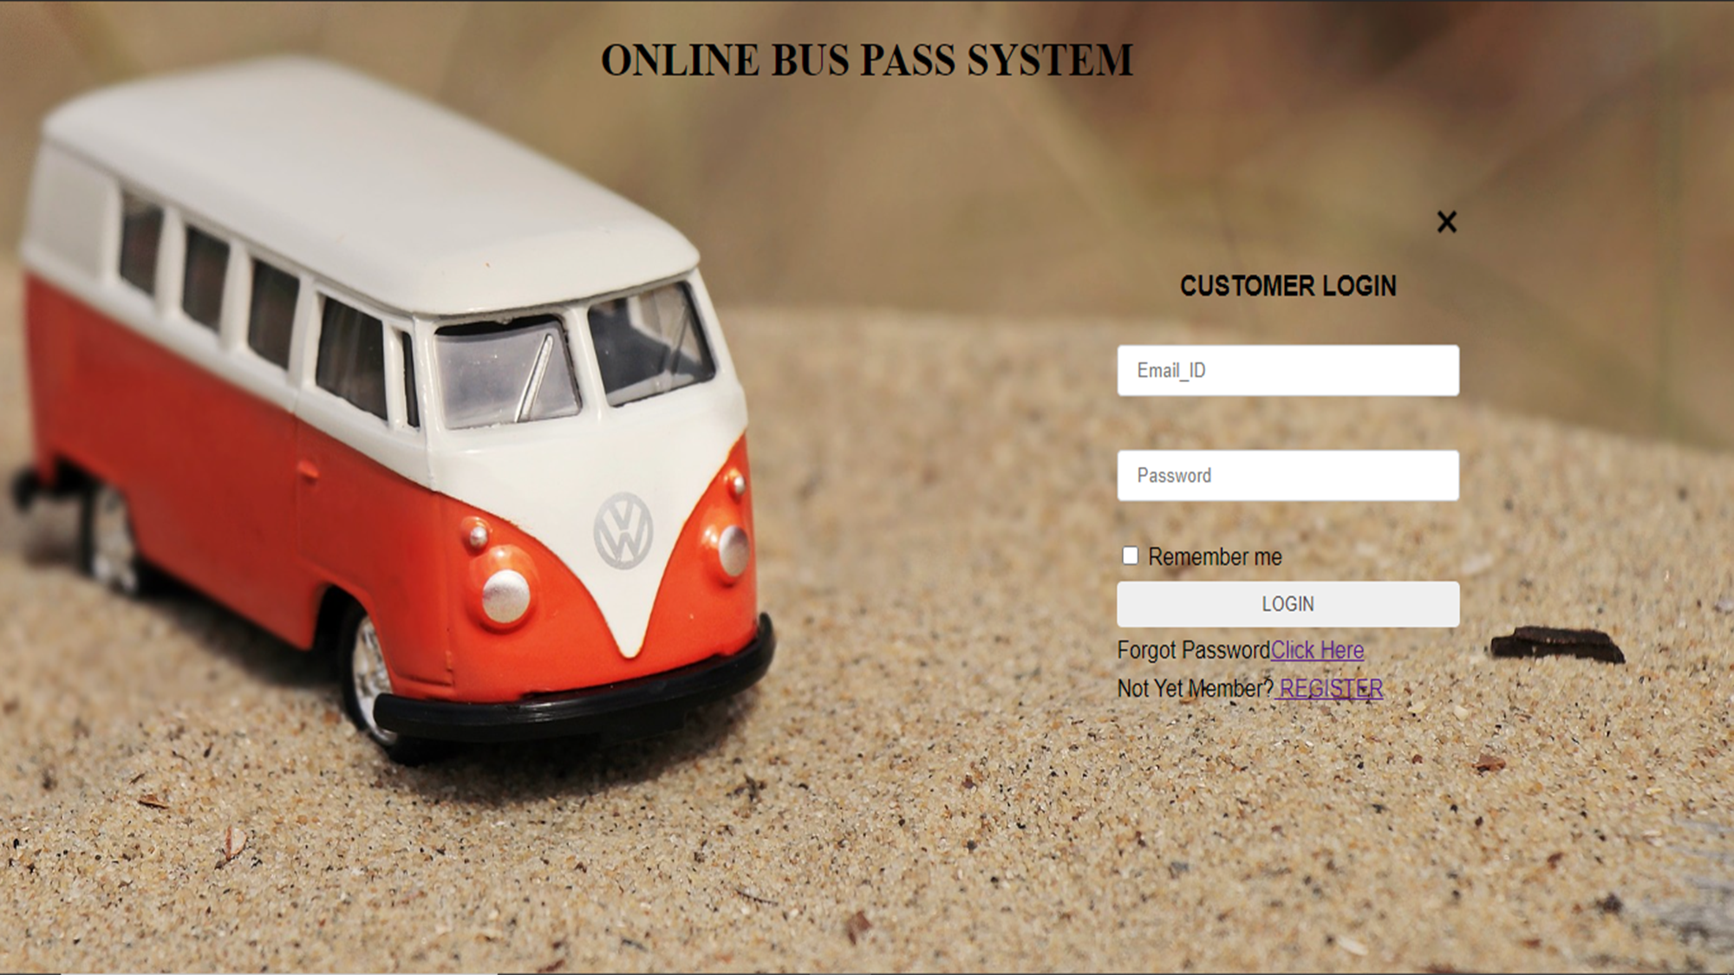

Slide 49
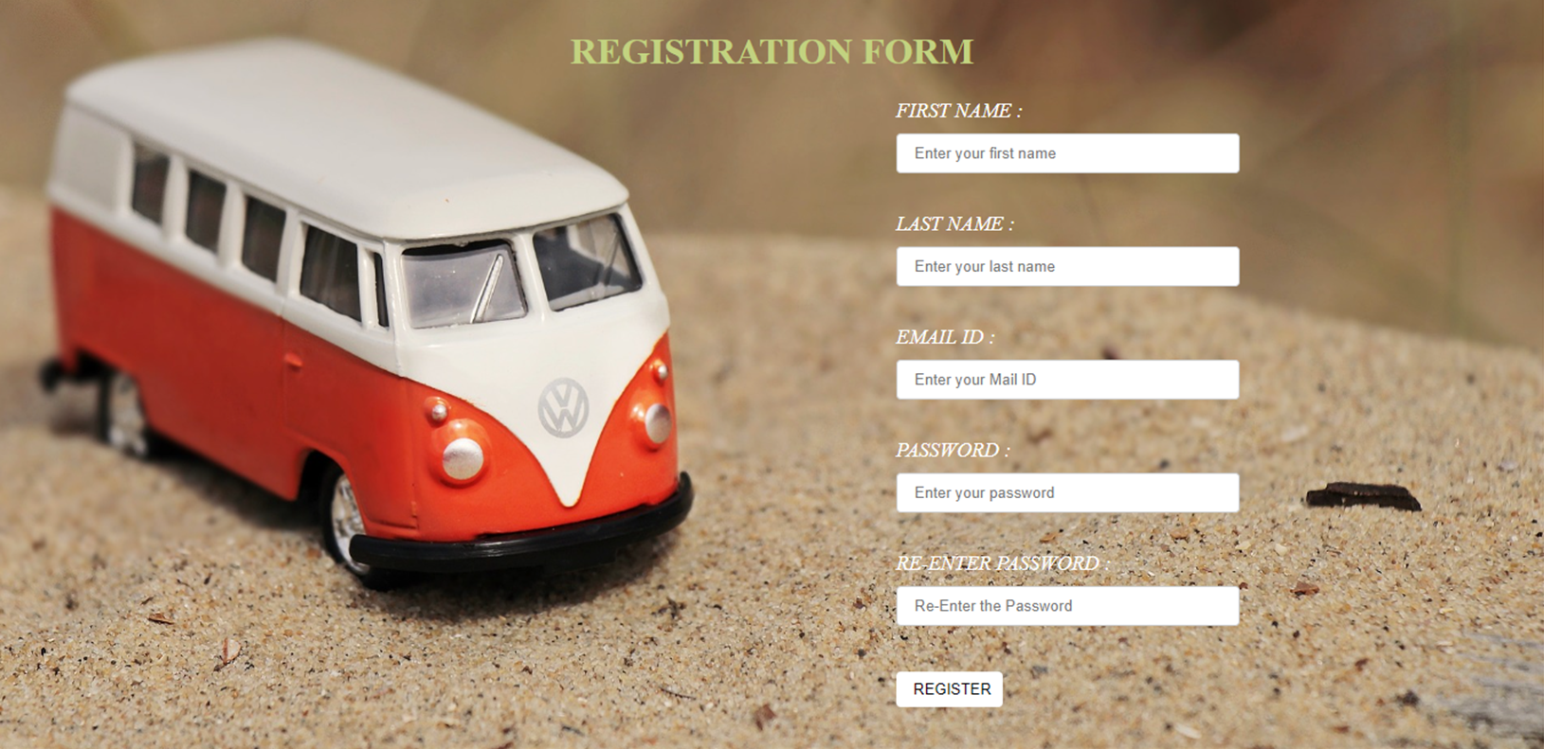

Slide 50
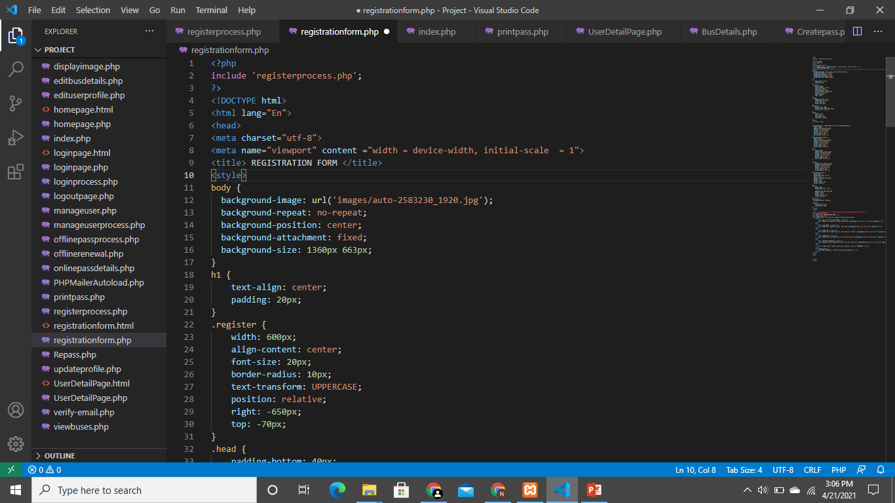

Slide 51
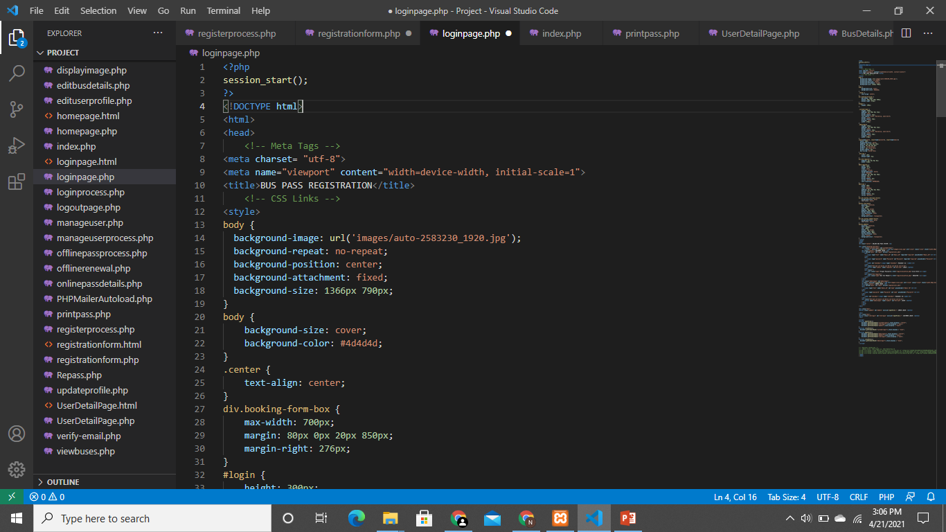

Slide 52
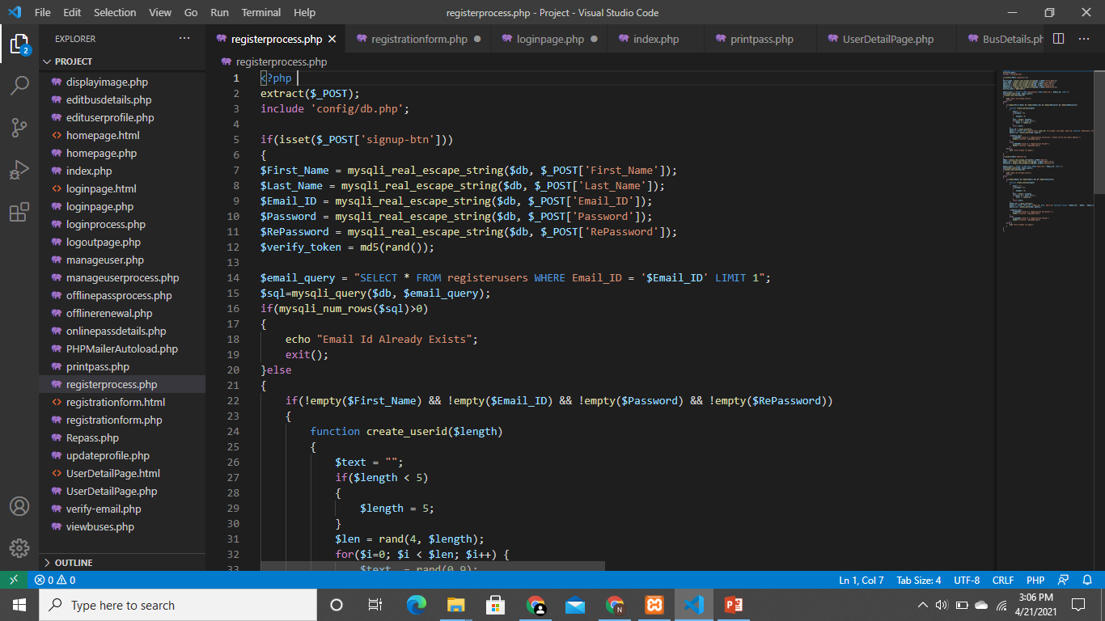

Slide 53
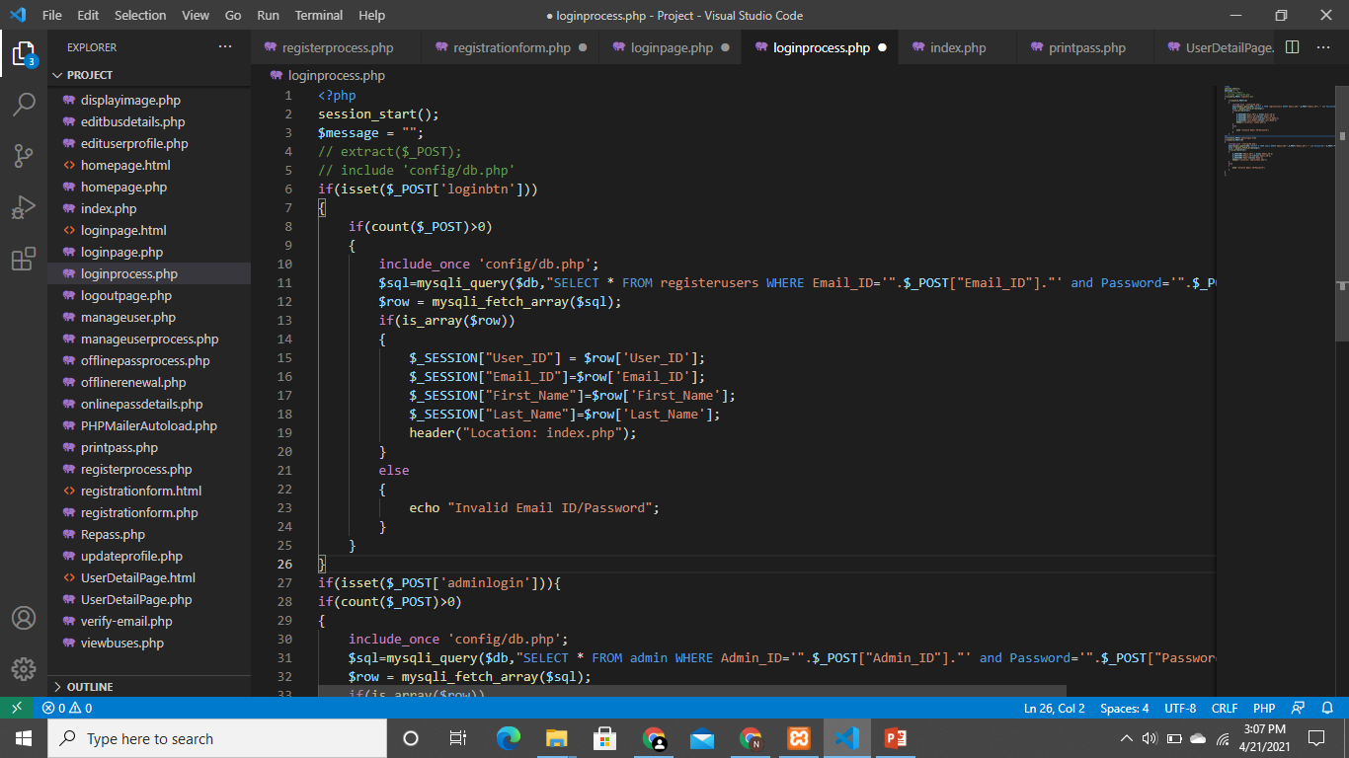

Slide 54
15.1 ESTIMATION OF TEST COVERAGE METRICS & STRUCTURAL CYCLOMATIC COMPLEXITY 15.1.1 CONTROL FLOW GRAPH
LOGIN
USER
ADMIN
TRUE
FALSE
FALSE
TRUE
HOME PAGE
REGISTER PAGE
REGISTER PAGE
HOME PAGE
MANAGE USER DETAILS
MANAGE USER DETAILS
MANAGE PASS DETAILS
MANAGE BUS DETAILS
PAYMENT
MANAGE PASS DETAILS
LOGOUT

Slide 55
15.1.2 McCabe's CYCLOMATIC COMPLEXITY
Cyclomatic complexity is a software metric used to measure the complexity of a program. It is a quantitative measure of independent paths in the source code of the program. Independent path is defined as a path that has at least one edge which has not been traversed before in any other paths. Cyclomatic complexity can be calculated with respect to functions, modules, methods or classes within a program. This metric was developed by Thomas J. McCabe in 1976 and it is based on a control flow representation of the program. Control flow depicts a program as a graph which consists of Nodes and Edges.
Mathematical representation:
Mathematically, it is a set of independent paths through the graph diagram. The
Code complexity of the program can be defined using the formula –
V(G) = E – N + 2
Where,
E - Number of edges
N - Number of Nodes

Slide 56
V(G) = P + 1 ,
Where P = Number of predicate nodes (node that contains condition).
CALCULATION:
E - Number of edges=16
N - Number of Nodes=14
V(G)=16-14+2=4
- Complexity =4
15.1.3 OPTIMUM VALUE OF CYCLOMATIC COMPLEXITY
Cyclomatic complexity is used to gauge the overall intricacy of an application or specific functionality within it. The software metric quantitatively measures a program's logical strength based on existing decision paths in the source code.
Complexity (M) = Edges (E) – Nodes (N) + Exit Nodes (P)
Complexity(M)=16-14+1=3;
Hence It is a Simple Module with low risk level.

Slide 57
16.1 DESIGN TESTING SUITES
16.1.1 SOFTWARE TESTING
Software testing is the process of evaluating a software item to detect differences between given input and expected output. Also to assess the features of A software item. Testing assesses the quality of the product. Software testing is a process that should be done during the development process. In other words software testing is a verification
and validation process.
16.1.2 TESTING FRAMEWORKS
MODULE BASED TESTING FRAMEWORK:
In the modular testing framework, testers create test scripts on module wise by breaking down the complete application under test into smaller, independent tests. In simple words, testers divide the application into multiple modules and create test scripts individually. These individual test scripts can be combined to make larger test scripts by using a master script to achieve the required scenarios.

Slide 58
KEYWORD DRIVEN TESTING FRAMEWORK:
In Keyword-driven testing, we use a table format to define keywords or action words for each function or method that we would execute. It performs automation test scripts based on the keywords specified in the excel sheet. By using this Framework, testers can work with keywords to develop any test automation script, testers with less programming knowledge would also be able to work on the test scripts.
16.1.3 MASTER TEST PLAN
TESTING OBJECTIVE | FOCUSING ON PERFORMNCE ISSUE
Test Items | Register, Login, Email Verification, Pass Validate Notification
Features to be Tested | Login verification, Generating Alerts For pass validity
Features not to be Tested | MySQL Connectivity
Approach | Manual testing
Required Hardware/Software | Web Browser, Internet Connectivity.
Risks | Alert Management
Testers & Schedule | Vignesh P, April 1st 2021
Estimate | -

Slide 59
16.1.4 MANUAL TESTING
TEST AREA | INPUT | TEST DESCRIPTION | RESULT
Login Module | Login username and password | Permits the user To enter into the Website. | Tested
Registration Module | User details(Name, Phone Number, Email ID, etc..) | Saves the Registered user Details to MySQL Database | Tested
Pass Generation | Admin generates the Bus pass to customer | Sends the message to Customer | Tested

Slide 60
17.1 DEPLOYMENT REPORT
USER:
Customer logs into the website using email.
He/she fills their personal details.
Customer selects the area and choose the bus number from the bus details page.
he/she creates the pass details from website.
ADMIN:
Admin login into online bus pass system.
The admin will manages the users information and creates/renews the user's passes.
Checks the area
Alert message will send to the customer if the details is correct.
Admin will add the bus details and modify the bus details to the database.

Slide 61
PASS GENERATION:
Required details of the customer will be submitted to admin.
Admin approves the user as the trusted one then the bus pass will be generated
And send to the students mail.
RENEWAL PASS:
Customer can login to his account for the renewal of bus pass.
Required details entered by the customer.
Then payment process will carried out.
Then the process is completed the user bus pass will be renewed automatically and send to user's mail.
By Using this website, each week has shown the report of different users. It is useful for the commuter who are facing problems with current manual work of bus system. It makes passenger easy to travel. Website shows maximum accuracy result and is efficient. therefore, the valuable time of the customer is saved.

Slide 62
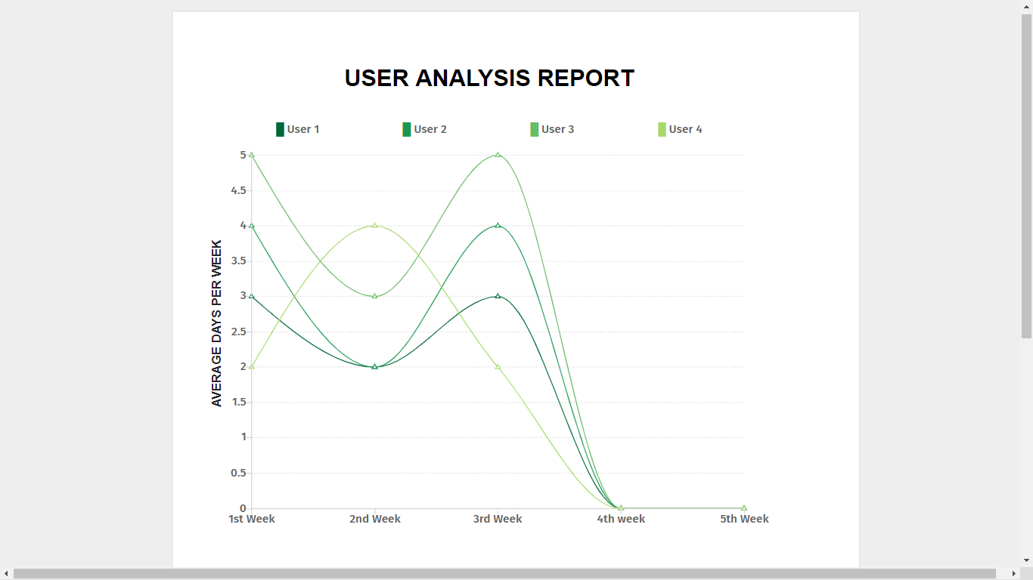

Slide 63
CONCLUSION:
At the Completion of this project we come to know that this system is useful for students and passengers who want to generate the pass from online. But there is a one bug about to paying fees online because generally the village students and passengers do not have online banking facility so this problem is occurs for state bus pass. But this is useful for city bus pass systems and metro train pass systems for big cities.

Slide 64
REFERENCES:
https://www.google.com
https://www.w3schools.com/php/default.asp
https://stackoverflow.com
http://www.hyderabadbusroutes.in/show-buses/all
SQL server tool kit

Slide 65
THANK YOU

